Slide 1

City & Hackney CAMHS Alliance
Understanding how CAMHS works
Sophie McElroy – Programme Manager
Mariona Garcia Edo – Project Manager
Aims of session
Context of City & Hackney CYP mental health
Overview of partners and providers
Tour of services
Questions
Notes:
Sophie

Slide 2
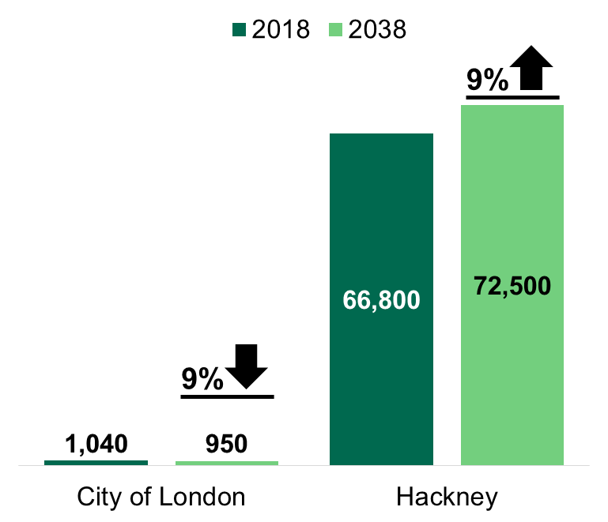
The local picture - age
Approx 24% of Hackney residents and 14% of City of London residents are between 0 and 18 years old.
The number of Hackney residents in this age group is predicted to increase by 9% in the next 20 years.
Notes:
Sophie

Slide 3
The local picture – mental health disorders
Estimated 3,900 of Hackney and the City residents aged 5-16 might be experiencing a mental health disorder
Conduct disorders in childhood are associated with significantly increased rate of mental health problems in adult life and up to 50% of children and young people with conduct disorder go on to develop antisocial personality disorder
Notes:
CAMHS

Slide 4
The local picture – meeting need
Estimated approximately 5861 children and young people have a mental health need that requires intervention (based on ONS estimates of 10.1% fixed on 14/15 population).
By the end of the last reporting year, local CAMHS provided treatment to 2395 children and young people. This means 40.9% of our CYP population is getting the mental health services they require
Significant proportion of remaining “unmet need” is likely to be being managed in primary care and other community based services [i.e. schools] , this represents a significant risk where some may not be receiving the level of care they require
Likely to be more significant in those groups who have been historically hard to reach such as young offenders, young people in gangs, those struggling at school and deprived families.
Notes:
CAMHS

Slide 5
The local picture in CYPMH
For further information please see City and Hackney CAMHS Transformation Plan
http://www.cityandhackneyccg.nhs.uk/about-us/our-plans.htm
(Scroll down to ”City and Hackney CAMHS Transformation Plan”
Notes:
Sophie

Slide 6
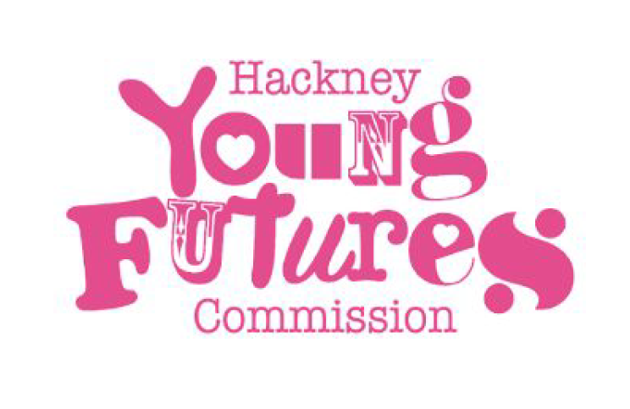
Young Futures Commission
1. Improving accessibility to confidential mental health services for
young people e.g. dedicated helpline during exams 8pm-8am
2. Working with schools and colleges to review current mental health
service delivery model
3. Reviewing current school policies that impact young people’s mental health e.g. school closures during mock exams
4. Improving counselling services and referral pathways
5. Increasing Young Hackney support services to those impacted by
stress-related issues
Notes:
Sophie

Slide 7
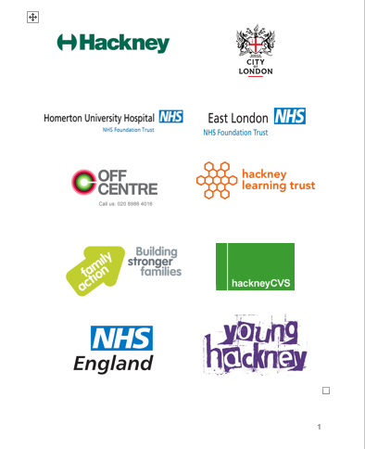
CAMHS Alliance in City & Hackney
CAMHS Alliance logo here
Partners
Commissioned providers
Specialist CAMHS
Moderate - Severe
First Steps
Early Intervention
CAMHS Disability
Moderate- Severe (Learning) Disabilities
Off Centre at Family Action
Voluntary sector support to families with complex needs
LBH CFS Clinical Team
Clinical Team for CYP & families known to CFS
Digital/online
KOOTH
Healios
Growing Minds
Voluntary sector, community led service for ACH communities
St Joseph’s Covid19 Bereavement Service
For children & families
Notes:
Sophie

Slide 8
First Steps
0-18
Mild to moderate mental health difficulties
Short term (6 week) intervention
Individual and group interventions
Working closely with parents/carers
Development of projects to support and empower community groups
Referrals by professionals (and return to self referral soon)

Slide 9
CAMHS Disability
0-19
Dual difficulties: mental health/emotional needs & disability
Autism Spectrum Disorder with disability
Under medical/therapy teams at Hackney Ark
Assessment, diagnosis, psycho-pharmacological intervention, therapeutic/behaviour support & intervention (parenting groups, sibling groups, ASD support), play specialist
Referral by professional or self referral by families known to the Ark

Slide 10
Referrals to First Steps
First Steps | Apr-19 | May-19 | Jun-19 | Jul-19 | Aug-19 | Sep-19 | Oct-19 | Nov-19 | Dec-19 | Jan-20 | Feb-20 | Mar-20 | Apr-20 | May-20 | Jun-20 | Jul-20 | Aug-20 | Sep-20
Referrals receieved | 179 | 158 | 96 | 119 | 103 | 114 | 154 | 137 | 145 | 122 | 170 | 108 | 27 | 45 | 80 | 105 | 56 | 106
Referrals accepted | 127 | 144 | 96 | 119 | 101 | 113 | 152 | 136 | 139 | 117 | 170 | 103 | 27 | 44 | 74 | 101 | 48 | 101
Referrals to CAMHS Disability
2019 |  | Received | Accepted |  |  | 2020 |  | Received | Accepted
 | Apr | 64 | 53 |  |  |  | Jan | 55 | 35
 | May | 56 | 48 |  |  |  | Feb | 61 | 30
 | Jun | 37 | 22 |  |  |  | Mar | 32 | 14
 | Jul | 64 | 48 |  |  |  | Apr | 8 | 8
 | Aug | 56 | 35 |  |  |  | May | 18 | 13
 | Sep | 52 | 31 |  |  |  | Jun | 24 | 15
 | Oct | 83 | 66 |  |  |  | Jul | 11 | 6
 | Nov | 49 | 29 |  |  |  | Aug | 8 | 7
 | Dec | 35 | 19 |  |  |  | Sep | 21 | 16
 | Total | 496 | 351 |  |  |  | Total | 238 | 144
Notes:
CAMHS

Slide 11
Specialist CAMHS
0-18
Moderate to severe emotional, behavioural and/or mental health difficulties
Unable to engage fully in everyday activities and/or relate well with others because of way thinking or feeling about themselves or others
Experiencing serious risks to their emotional and psychological wellbeing development
Complex factors requiring multi-disciplinary support e.g. individual, group, family therapy & medical treatment
Referral by professional only or self referral if returning/known to service

Slide 12
Referrals to Specialist CAMHS
Referrals Received & Accepted |  | Apr-19 | May-19 | Jun-19 | Jul-19 | Aug-19 | Sep-19 | Oct-19 | Nov-19 | Dec-19 | Jan-20 | Feb-20 | Mar-20 | YTD | Increase or decrease from 2018/19
City & Hackney CAMHS | Received | 136 | 157 | 161 | 134 | 96 | 136 | 166 | 162 | 128 | 151 | 212 | 137 | 1776 | 210
 | Accepted | 92 | 88 | 48 | 84 | 78 | 90 | 105 | 108 | 72 | 109 | 115 | 90 | 1079 | -66
Referrals Received & Accepted |  | Apr-20 | May-20 | Jun-20 | Jul-20 | Aug-20 | YTD
City & Hackney CAMHS | Received | 41 | 125 | 140 | 143 | 99 | 548
 | Accepted | 15 | 73 | 108 | 106 | 65 | 367
Notes:
CAMHS

Slide 13
Children & Families Clinical Service
0-25
Known to Children’s Social Care, Young Hackney, Youth Offending Team, Family Support, Looked After Child
Integrated with above services
Offering specialist clinical assessment, individual, family & group therapy
Working with cyp who have mental health needs, experiencing issues, stressors, are struggling with emotional & behavioural issues and where there are child protection concerns
Referral by services within CFS

Slide 14
Off Centre
11-25
Voluntary/community sector
Support for emotional and practical issues e.g. stress, abuse, family breakdown, neglect, depression, accommodation, education, identity…
Therapeutic service (16-25) – one to one counselling, psychotherapy & art therapy, art making group
Psychosocial service (11-25) – advice & information, therapeutic drop-in, Project Indigo (LGBTQI+ for 13-25)
Self or professional referral

Slide 15
Family Action
16+
Practical, emotional & financial support
Complex needs and challenges for those experiencing poverty, disadvantage & social isolation e.g. domestic abuse, substance misuse, mental health needs
Offers intensive family support, specialist therapeutic work, conflict management, relationship support, advice & wellbeing services.
Parent support courses (Parents as Partners) for families with at least one child under age of 11
Self referral or by GP & other professionals

Slide 16
Young Hackney
6-19 (or up to 25 for SEND)
Range of individual support in number of settings (home, school, community)
Universal services + individual help for those with additional need e.g. at risk of exclusion from school, NEET, at risk of offending, victims or perpetrators of violence, at risk of sexual or other types of exploitation, Young Carers, impacted by inequality & discrimination
Substance misuse service
Self or professional referral

Slide 17
CAMHS Extended Crisis Service
Up to 18
Based in Emergency Department (A&E) at Royal London, Homerton & Newham University Hospital
9am – 9pm (7 days)
Crisis line 24/7
  At risk of immediate and significant self-harm
  Emotionally or psychologically distressed
  Having thoughts of suicide
  Struggling to manage immediate outburst that puts you or others at risk
Self-refer by attending A&E or calling crisis line

Slide 18
Kooth.com
11-18 (or 25 if registered before 18th birthday)
Online platform – 24/7, 365 days per year
Early response to and identification of emotional, wellbeing and mental health problems
Self-care tools & resources to build resilience
Removing barriers for those not traditionally accessing services
Offers messaging, one to one counselling, forums/discussion groups and magazine articles (often peer written)
Self-referral and signposting by professionals & parents/carers

Slide 19
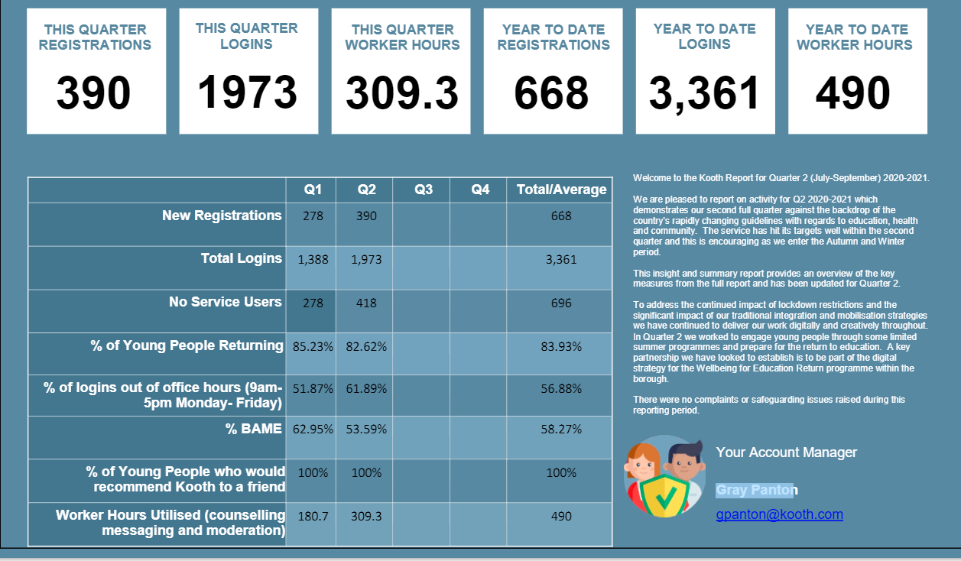
Notes:
Sophie

Slide 20
Healios
7 – 18 years old
Post diagnostic interventions for ASD and ADHD, and CBT for moderate/severe Anxiety and Depression.
Integrated within Specialist CAMHS but offered by Healios clinicians, completely online.
Sessions can be offered 8am-8pm, 7 days a week.
Treatments up to 10 sessions long.
Referrals can be made by professionals from any of CAMHS Alliance services with Family/YP consent.

Slide 21
St Joseph’s Bereavement Service
Up to 18 & families
Loss of family member, care giver or other significant person due to Covid-19
Individual counselling
Family sessions
Bereavement groups and memorial events
Art therapy
Self-referral or by professionals

Slide 22
Growing Minds
0-25
African, Caribbean & mixed heritage
1-1, group interventions to cyp & parents
Counselling & practical/skills support
Joint community project (Off Centre, Hackney CVS, African Community School, Father2Father, Black Parent Community Forum
Self referral or by professional

Slide 23
WAMHS
CAMHS Workers in Schools (CWIS)
Wellbeing Framework Partners (WFP)
Mental Health Lead in schools (MHL)
Whole school approaches (69/80 schools + 5 OJ independent)
Allocated CAMHS worker and Wellbeing Framework Partner (Hackney Education)
Increase access for ALL children and young people to mental health services.
Promote cohesive and cooperative linked working between schools and mental health services.
Increase capacity within schools to identify need early and meet the wellbeing and mental health needs of all pupils.
Embed whole school approaches to mental health and wellbeing

Slide 24
Wellbeing Framework
Leadership & Management
that supports and champions efforts to promote emotional health and wellbeing
Targeted support and appropriate referrals
Identifying Need and Monitoring Impact of Interventions
Curriculum, teaching and learning to promote resilience and supporting social & emotional learning
Staff development to support their own wellbeing and that of students
Working with parents and carers
Enabling student voice to influence decisions
Behaviour Policies in schools that promote wellbeing and self regulation
Ethos and environment that promotes respect and values diversity.
Audit tool covering areas for development
Action plan based on audit
Co-ordinated by WBF, with MHL & CWIS
Notes:
Sophie

Slide 25
CAMHS Worker in School Role
Attending Multi Agency planning ( MAP) meeting
Issue based consultation
Student based consultation
Training
Liaison and signposting
Ongoing advice and support to the school organization
Reflective practice for school staff
Recommending appropriate mental health resources and interventions
Supporting contact with parents
Notes:
CAMHS

Slide 26
Mental Health Support Team (in schools)
Currently in Phase 1 WAMHS schools (38)
Planned for Phase 2 WAMHS schools (2021)
Workshops
Coffee mornings
PSHE
Supporting teacher training
Whole School approaches
Consultation & Signposting
Targeted interventions
Telephone triage
Consultation for teachers or parents
Liaison with CAMHS and other agencies
Manualised individual or group interventions
Primary - parent focused for child challenging behaviour or anxiety
Secondary – adolescent low mood or anxiety

Slide 27
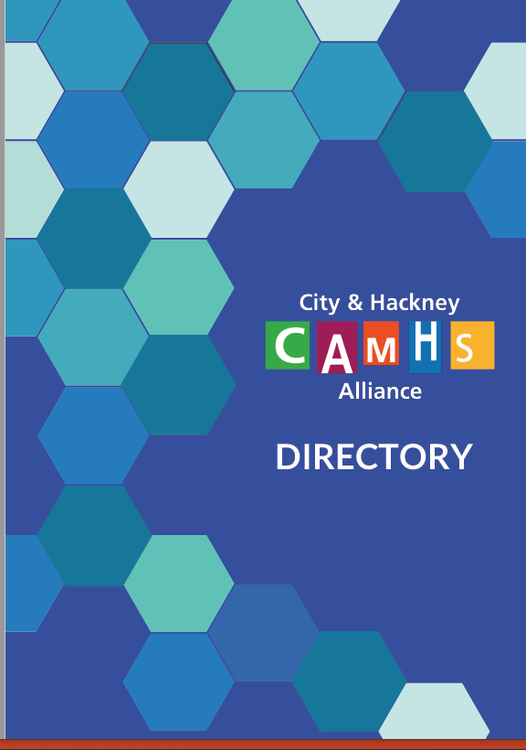
Information
Comprehensive guide to services – available on
For more info on services go to
https://cityandhackneycamhs.org.uk/
Notes:
Sophie

Slide 28
Current challenges
Covid -19: remote delivery, greater complexity in cases, reduced workforce, concern about possible surge later
Recruitment & retention of mental health professionals
Capacity for all – Time poor, change weary
Lack of data about pupil wellbeing
Notes:
Sophie

Slide 29

Questions

